Slide 1
LaPave Walkthrough
Asphalt 501/502

Slide 2
Basics
File is locked down to prevent overwriting of formulas
Light blue cells are for user inputs, some may be drop downs
One file per Lot

Slide 3
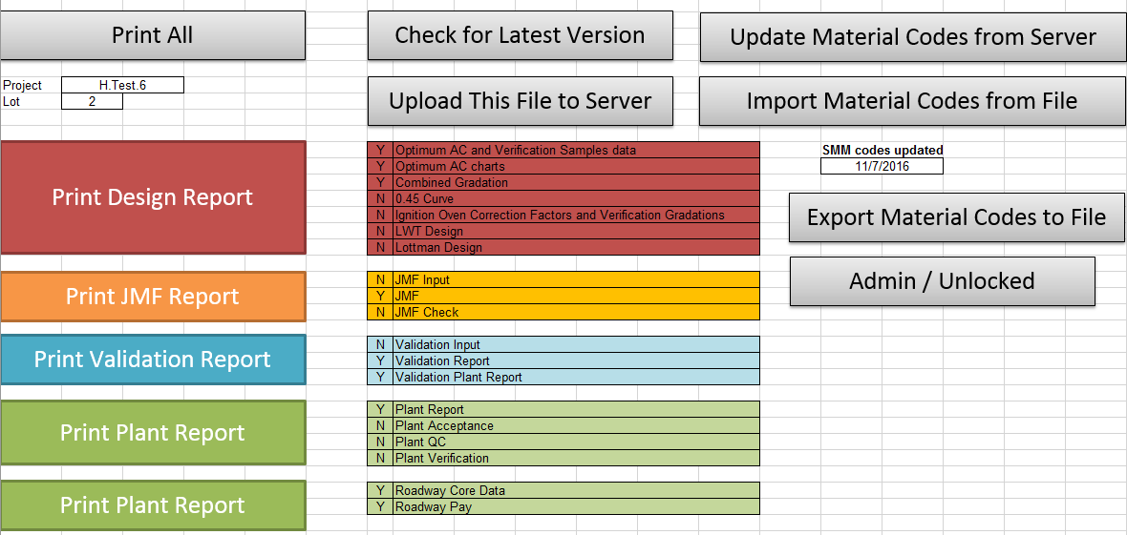
Reporting Tab
[Import Mat Code] – imports SiteManager codes from server or another file
[Check Latest Version] – checks for newer version on the shared location [internal only]
[Upload File to Server] – uploads to shared location on DOTD network [internal only]
[Print]s – can select Y/N on sections to print

Slide 4
Material Setup Tab
Users select materials typically used in their plant, some values can be completed here, these will populate throughout the file.
Custom name set by user to distinguish if two aggregates from same source.
Options to import/export materials setup too

Slide 5
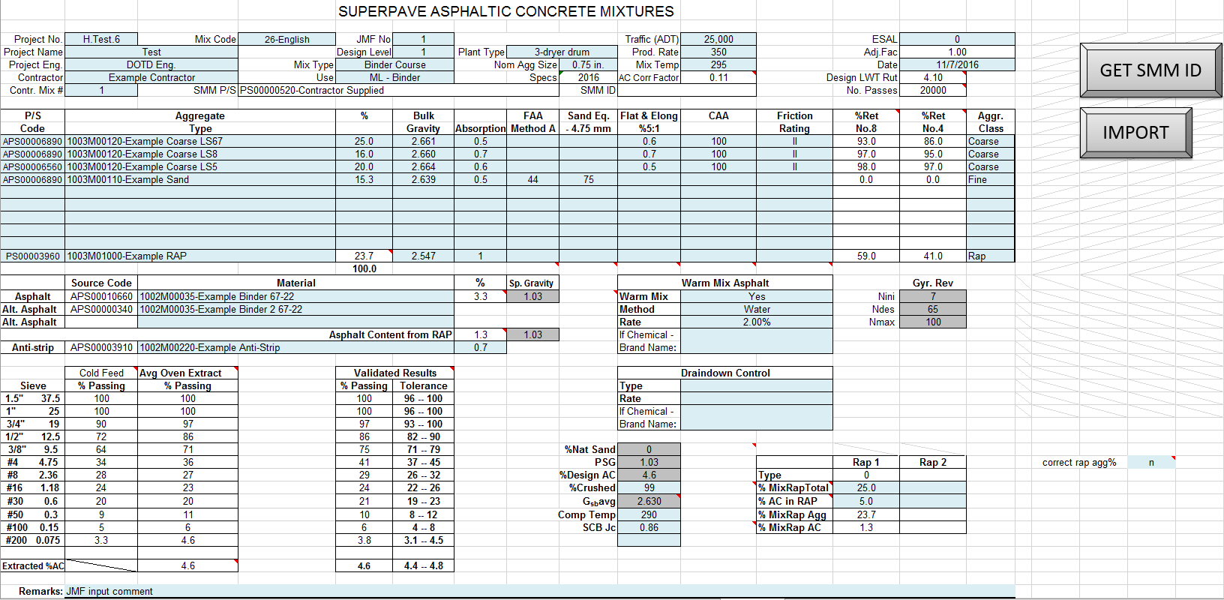
JMF Input Tab
[Import] button will import JMF data from another LaPave file of similar type
(includes material setup)

Slide 6
JMF Input Tab
JMF header info
Mix Type, Use, and Nom Agg Size will set limits for other parts of the application
Project and mix info will be populated to other sheets

Slide 7
JMF Input Tab
Aggregate entry
Select Aggregate class (this will update aggregate type dropdowns to match materials setup)
Select Aggregate Types (if material setup value are filled, sheet will populate with these)
Aggregate % will be transferred to the aggregate design tab
%Ret No.8 and No.4 are populated from the aggregate design tab
Flags will show if entry does not meet spec for selected mix type

Slide 8
JMF Input Tab
Enter Asphalt Information
Warm mix and Rap information are here also
Gradations are populated from design and validation

Slide 9
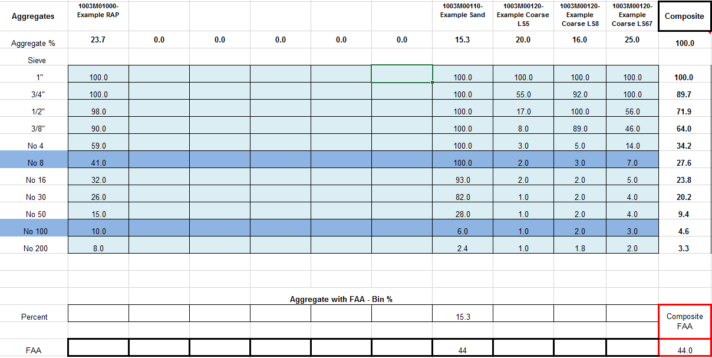
Comp. Grad. And FAA Input Tab
Aggregate names and % will be transferred here
Values will pull from material setup, but users can manually enter or update gradation.

Slide 10
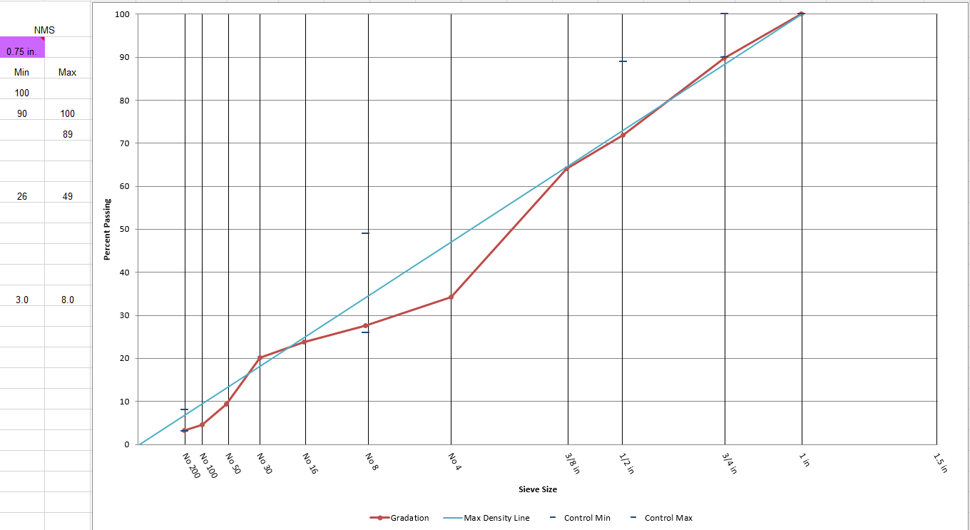
Comp. Grad. And FAA Input Tab
The composite gradation will be plotted with the spec limits of the mix type selected on the JMF input tab
Flags show if out of spec

Slide 11
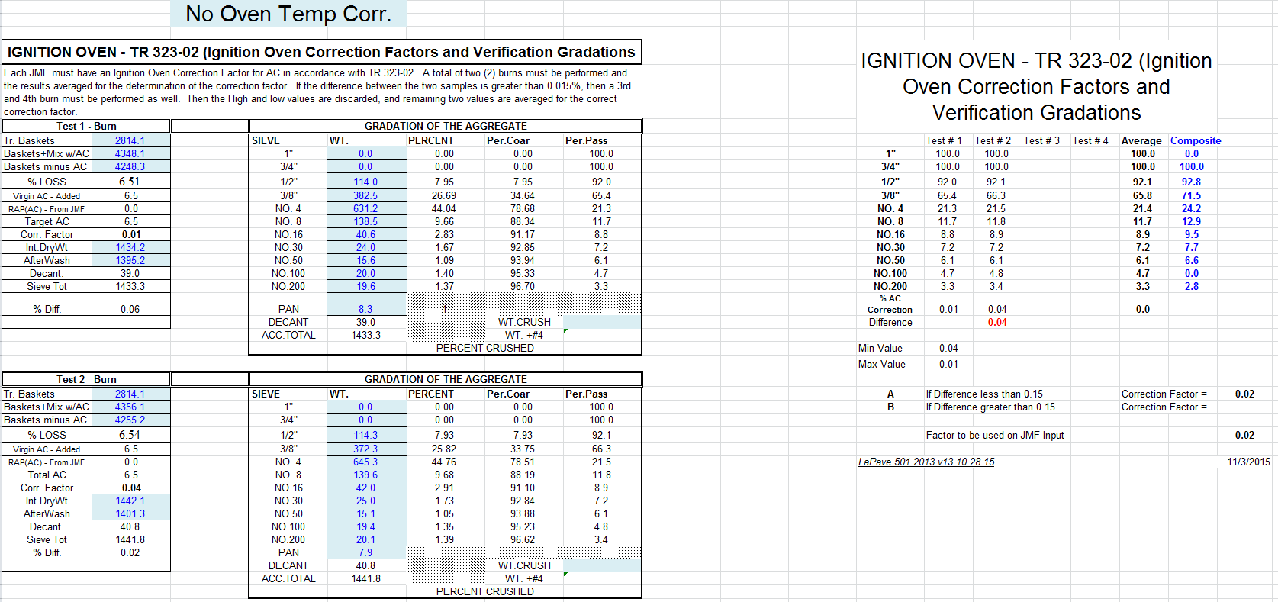
Comp. Grad. And FAA Input Tab
Ignition oven test entries can be found below the gradation entry
Entry fields will change depending on the oven temperature correction selection

Slide 12
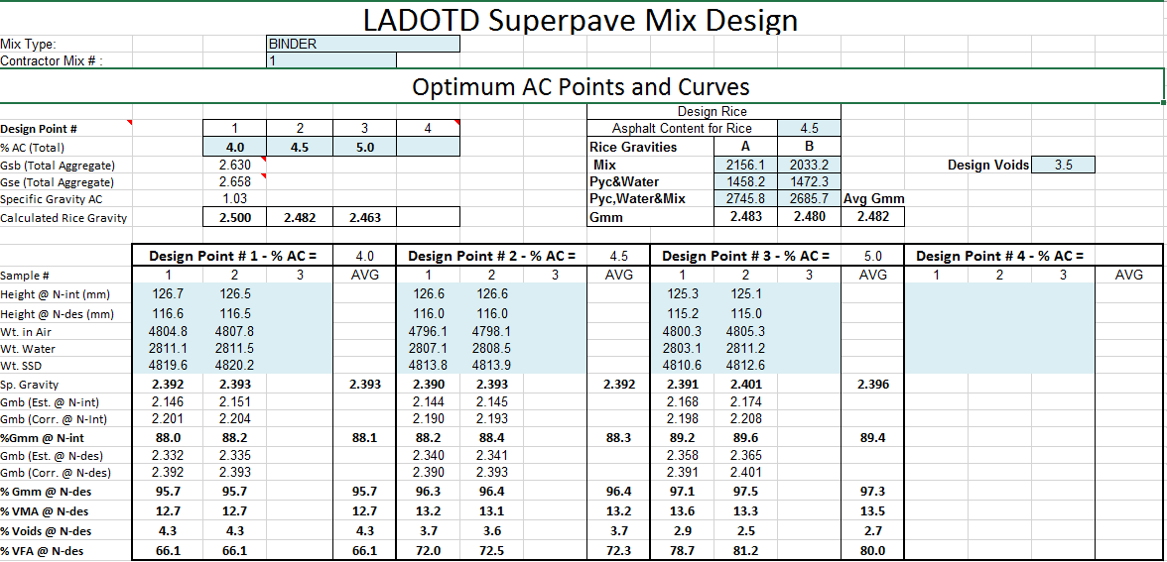
Optimum AC Test Results Tab
Enter design rice and design brick information

Slide 13
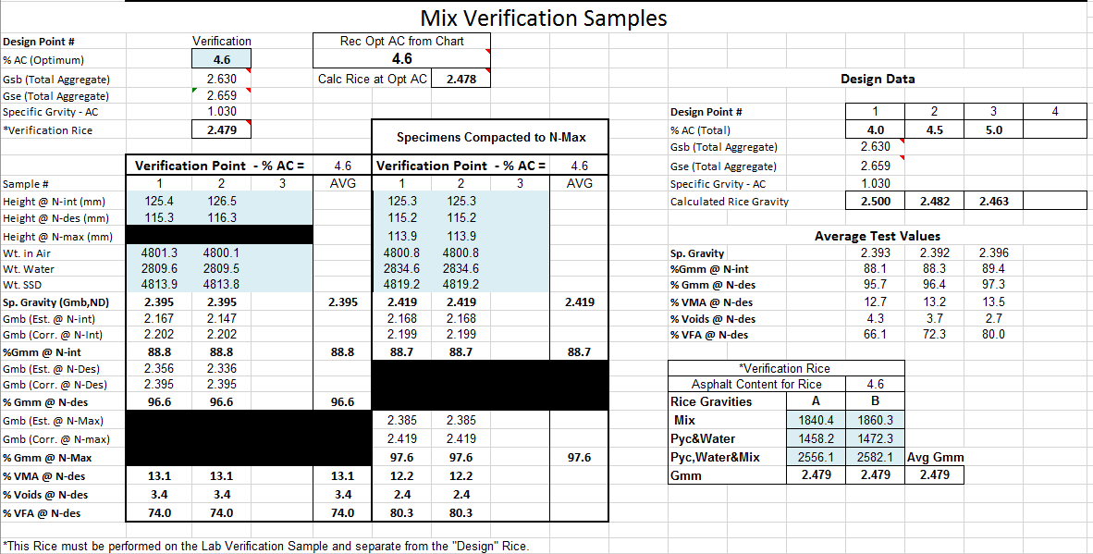
Optimum AC Test Results Tab
Enter design verification brick information in the section below

Slide 14
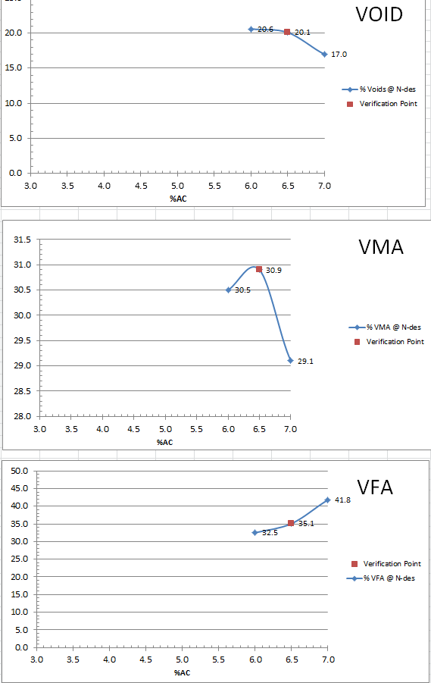
Optimum AC Test Results Tab
Some parameters will be plotted with design data vs. verification data

Slide 15
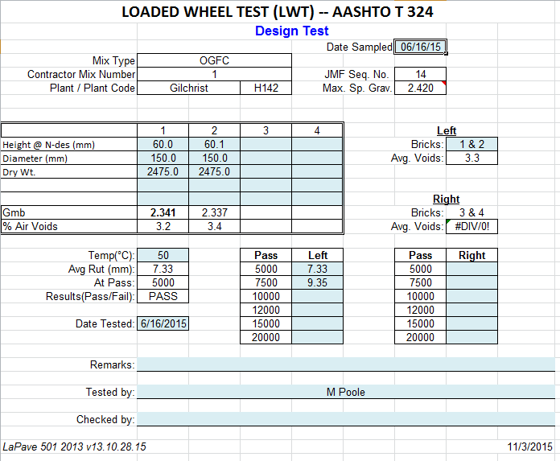
Moisture Susceptibility Design Tab
Enter LWT or TSR data for design and verification here

Slide 16
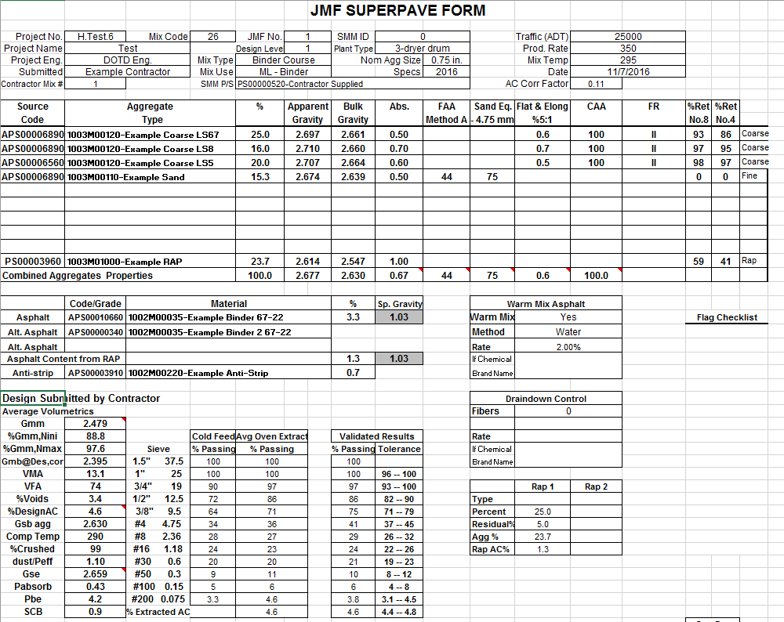
JMF Check Tab
Summary sheet to check values
A flag checklist is located here that will show any JMF related flags
Signature lines
There is a dropdown to select if JMF parameters are computed off design %air or the verification briq

Slide 17
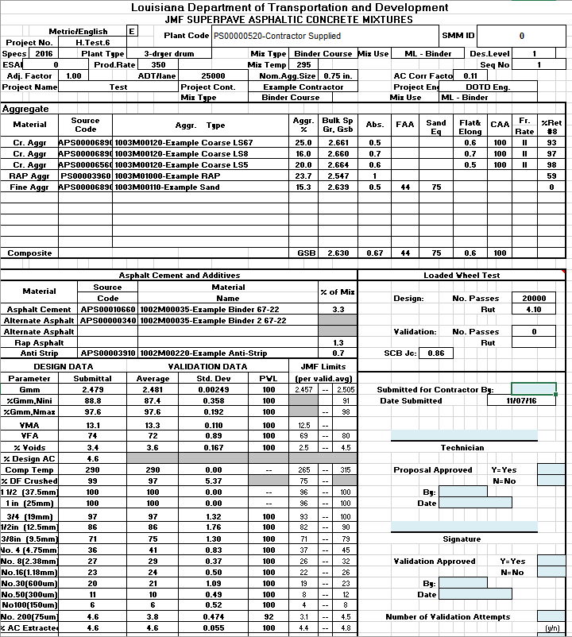
JMF Tab
Printable JMF page in DOTD format
Populates from design and validation tabs

Slide 18
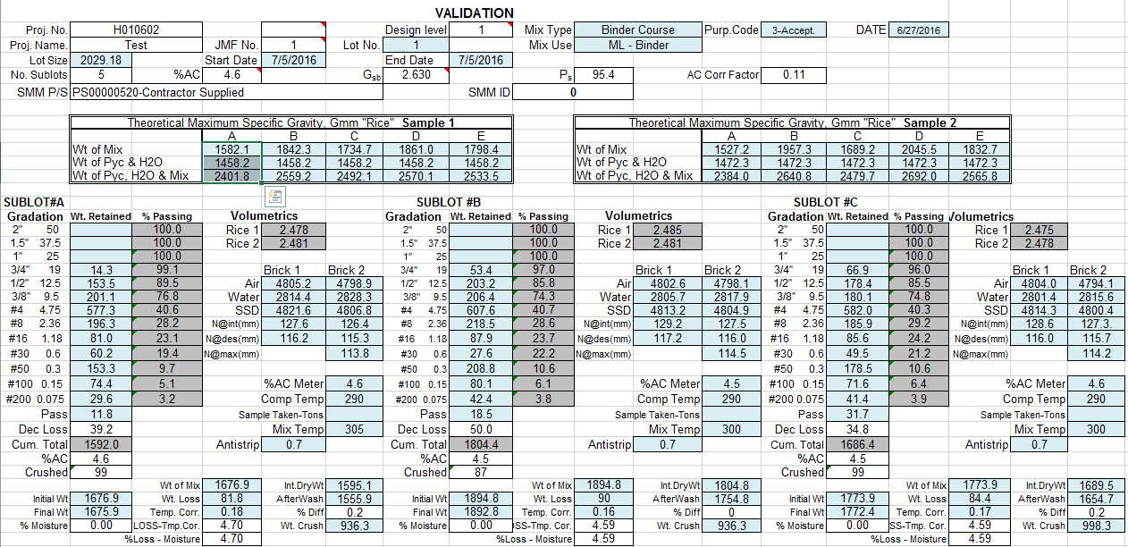
Validation Input Tab
Input for sublots for validation of JMF
Users can select burn oven options, entry fields change depending on selection
Roadway cores can be entered at the bottom

Slide 19
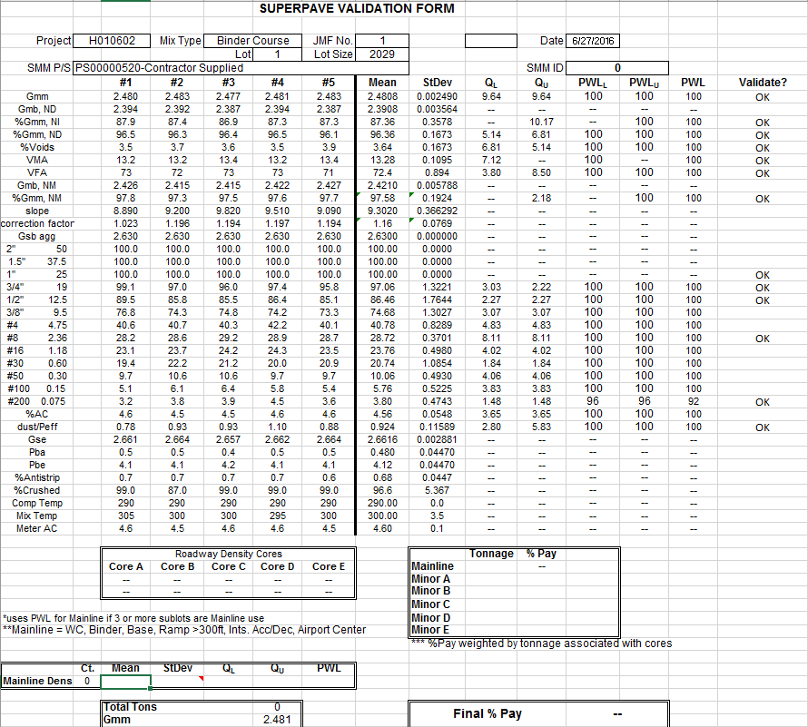
Validation Tab
Summary for validation inputs
Runs statistics for validation
Flags if parameters are not meeting spec of selected mix type in JMF
show PWL and %pay

Slide 20
Plant Tabs
Plant acceptance – up to 6 sublots for DOTD submission
Plant report pulls from Plant acceptance
Plant QC – up to 6 sublots for contractor use
Plant Verification up to 3 sublots for DOTD use

Slide 21
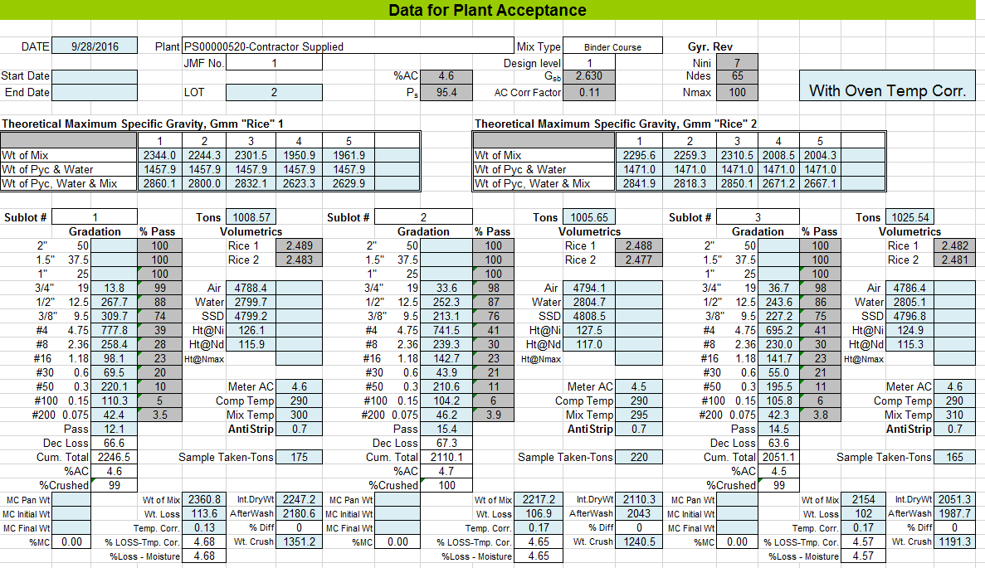
Plant Tabs
Typical plant entry fields
Sublot 6 will activate if tonnage is entered

Slide 22
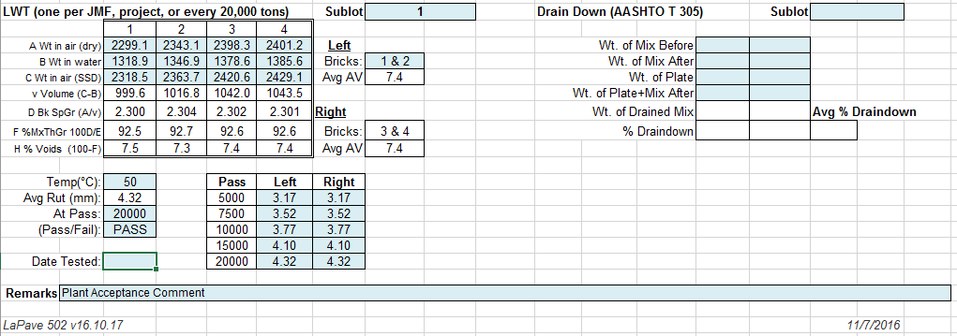
Plant Tabs
Entry for LWT and drain down testing below sublots

Slide 23
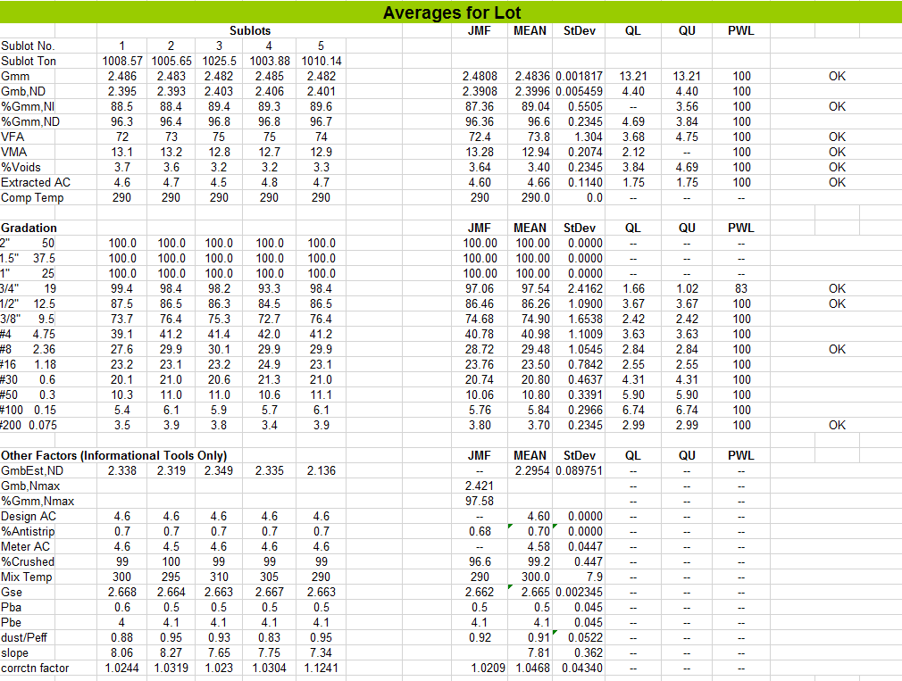
Plant Tabs
Lot statistics below
flags will show for items out of spec

Slide 24
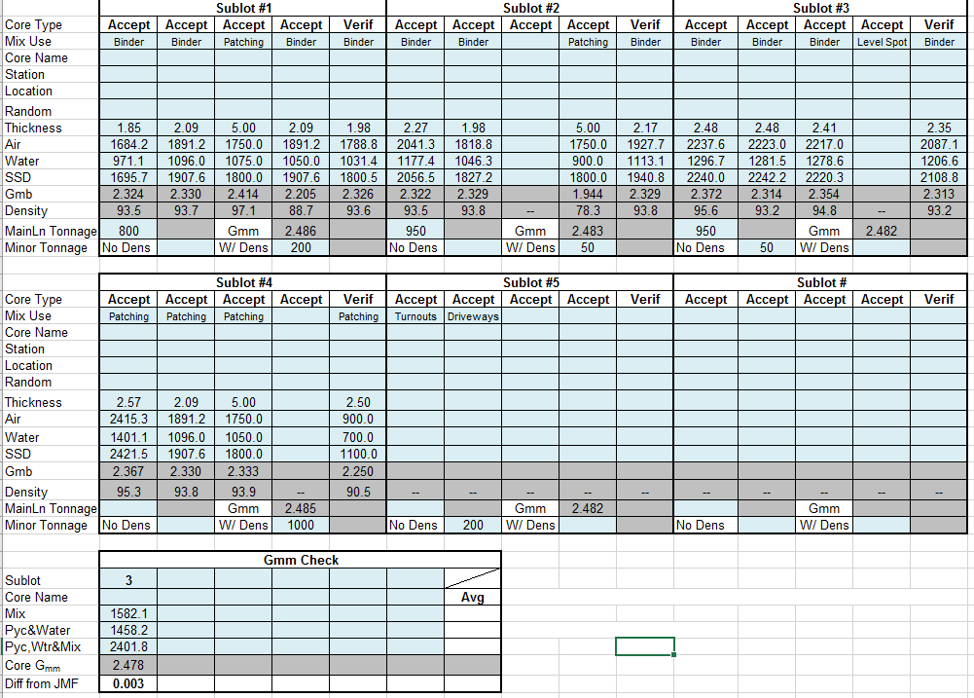
Roadway Tab
Entry for cores by sublot
up to 4 acceptance
1 verification
ML/minor determined by mix use selected
Gmm pulled from plant acceptance
Entry for Gmm check
If out of tolerance, flag will show to test remaining

Slide 25
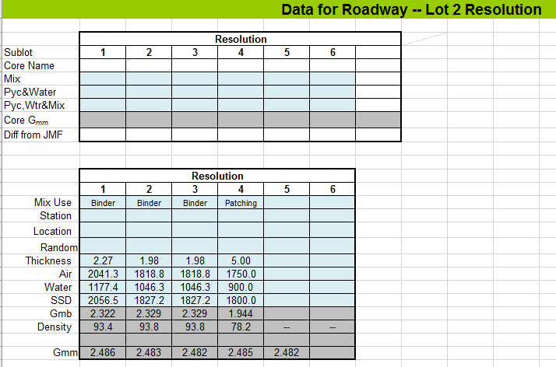
Roadway Tab
If resolution Gmm is filled, the average resolution Gmm will become the Gmm used for all core calculation for the lot
If resolution cores is filled, the core values will be used to calculate pay

Slide 26
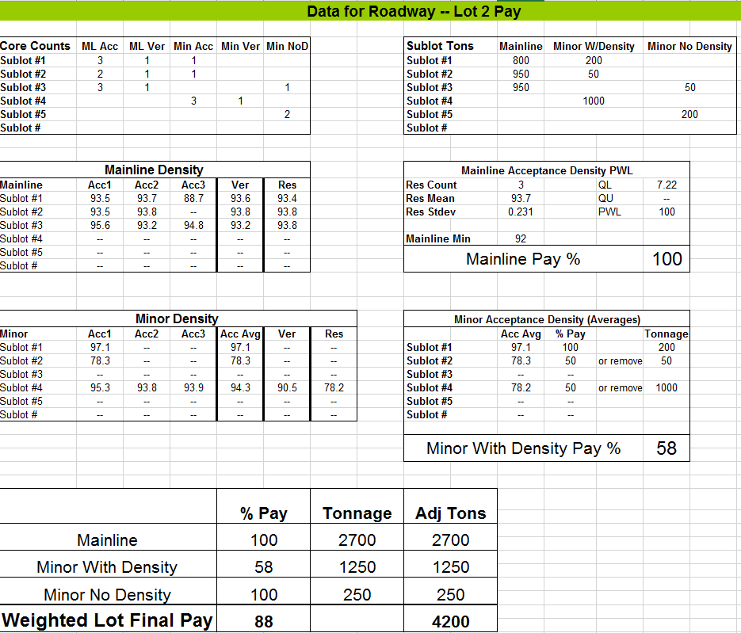
Roadway Tab
Pay sheet determines count for ML/minor uses
Tonnage summary
All Mainline cores are used for PWL for pay
If ML Resolution cores, resolution cores used for PWL for pay
Average of Minor cores for each sublot is used for pay, then weighted average by tons to determined final pay
If Minor Resolution cores, the core will replace the sublot average for pay
Final pay computed with weighted average by tons

